Slide 1
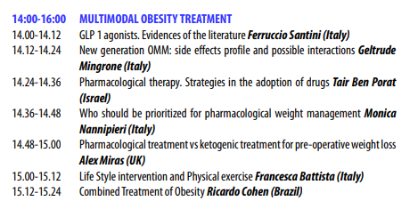






AZIENDA OSPEDALIERO - UNIVERSITARIA PISANA
U.O. ENDOCRINOLOGIA 1
Direttore Prof. Ferruccio Santini
Sezione Centro Obesità e Lipodistrofie

Slide 2



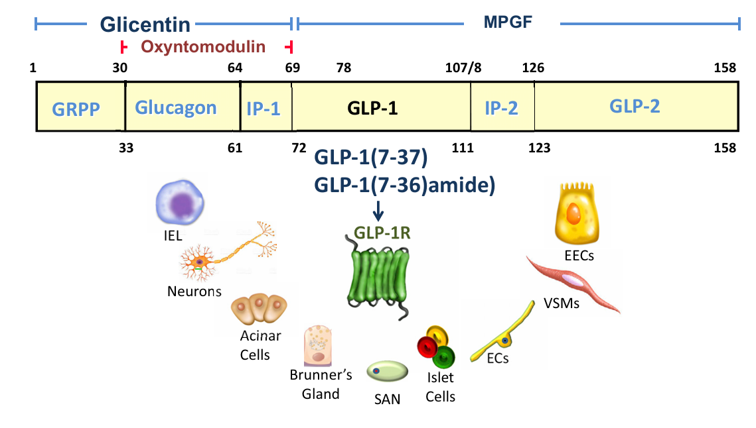
Figure 1. Structure of Mammalian Proglucagon and the Proglucagon-Derived Peptides, and Principal Cell Types that Express the Canonical GLP-1 Receptor GRPP, glicentin-related pancreatic polypeptide; IP-1 and IP-2, intervening peptides 1 and 2; GLP 1R, GLP-1 receptor; IEL, intraepithelial lympho cyte; VSM, vascular smooth muscle cell; SAN, sinoatrial node cell; EC, endothelial cell; EEC, enteroendocrine cell; MPGF, major proglucagon fragment.

Slide 3
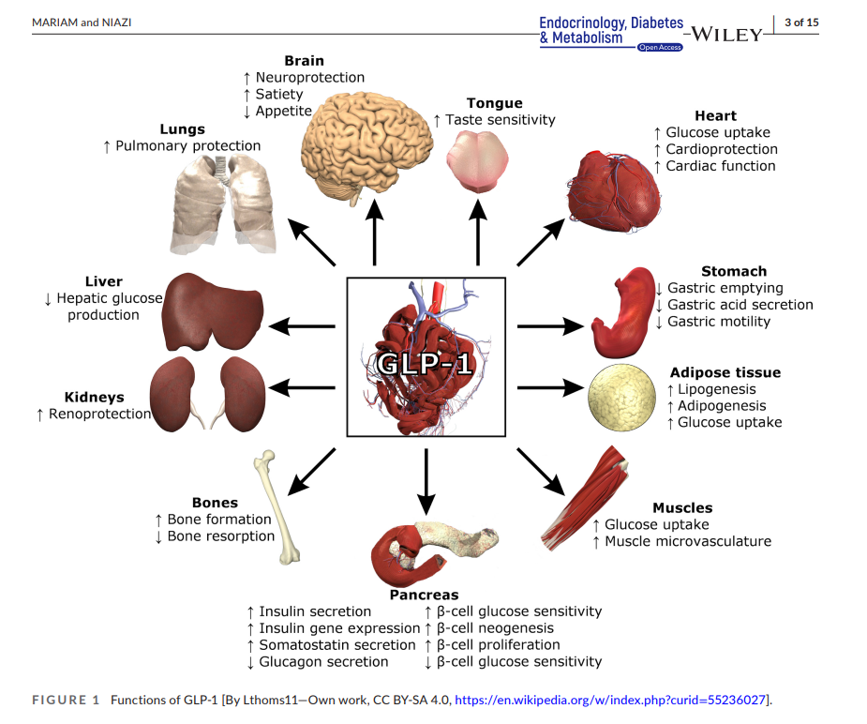


Slide 4

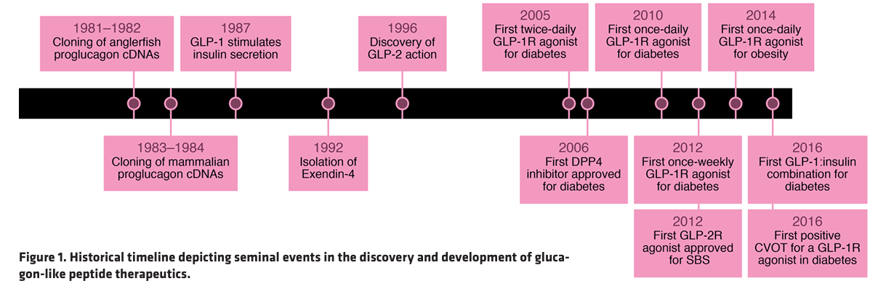



Slide 5
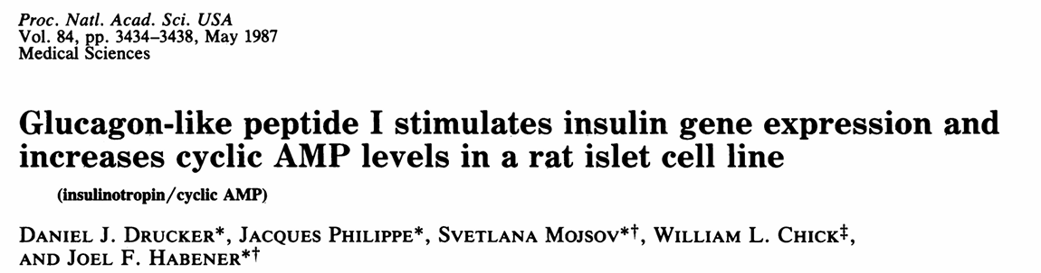
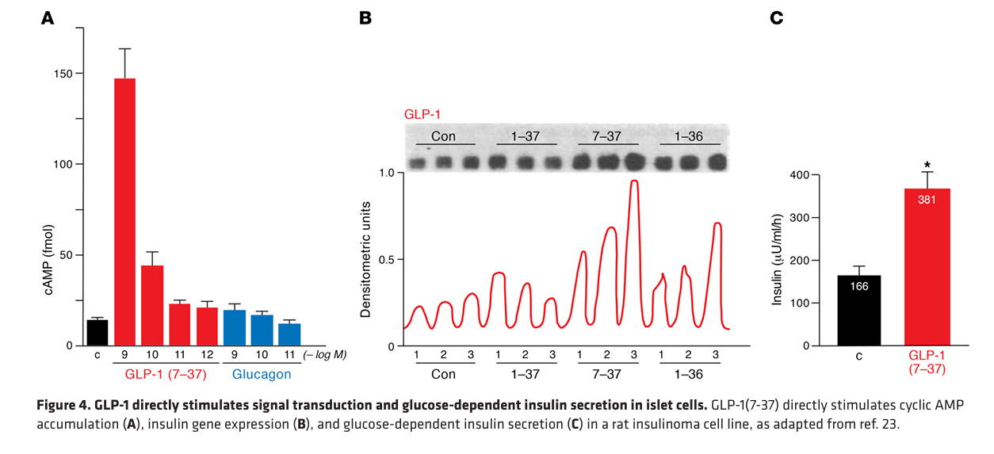
Adapted by Drucker et al. J. Clin. Invest. 2017

Slide 6
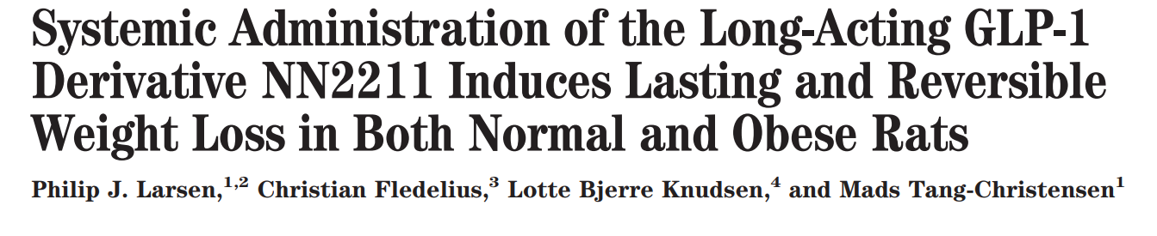
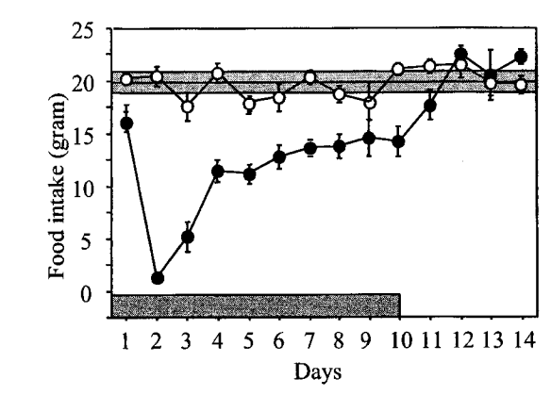


Slide 7

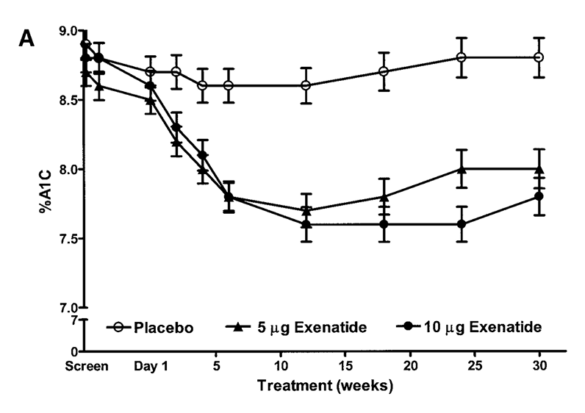
Buse et al. Diabetes Care 2004

Slide 8

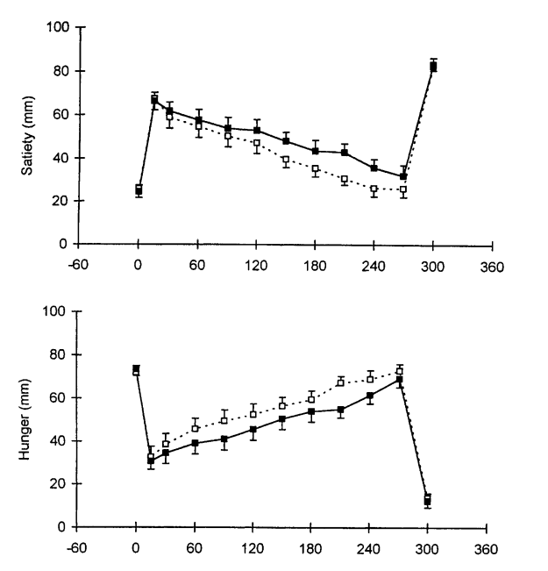
J. Clin. Invest. 1998

Slide 9
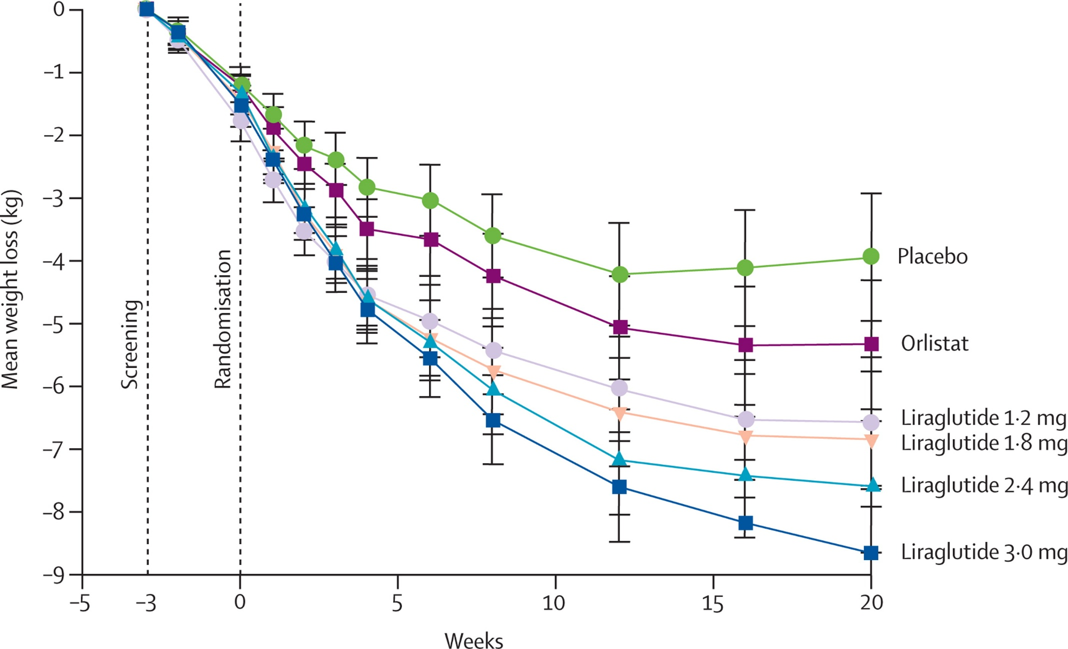
Effects of liraglutide in the treatment of obesity: a randomised, double-blind, placebo-controlled study
Astrup et al. The Lancet 2009

Slide 10
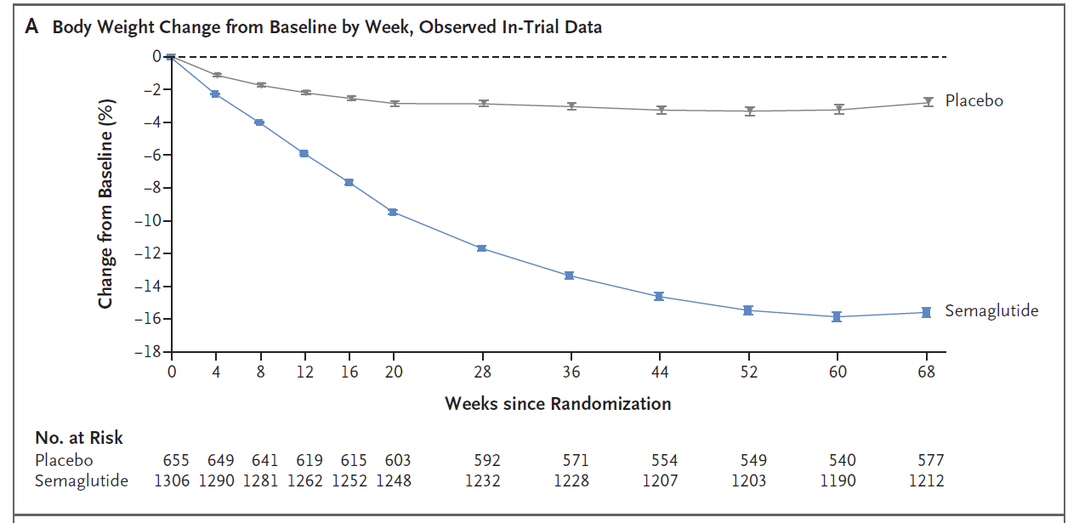
Wilding JPH, et al.

Slide 11

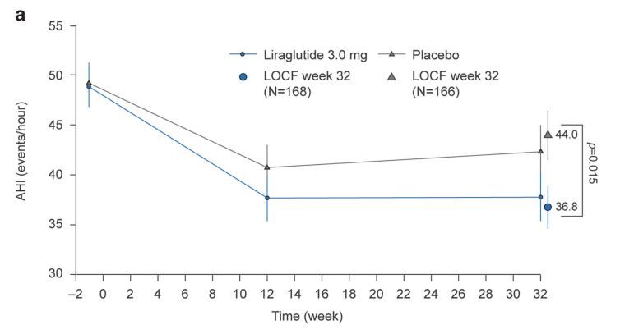

Slide 12
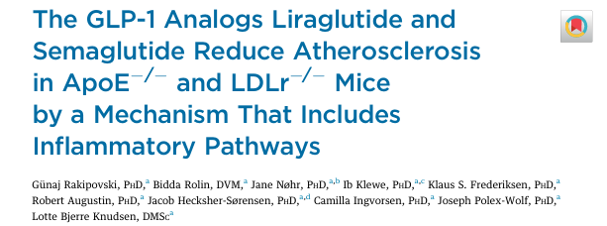
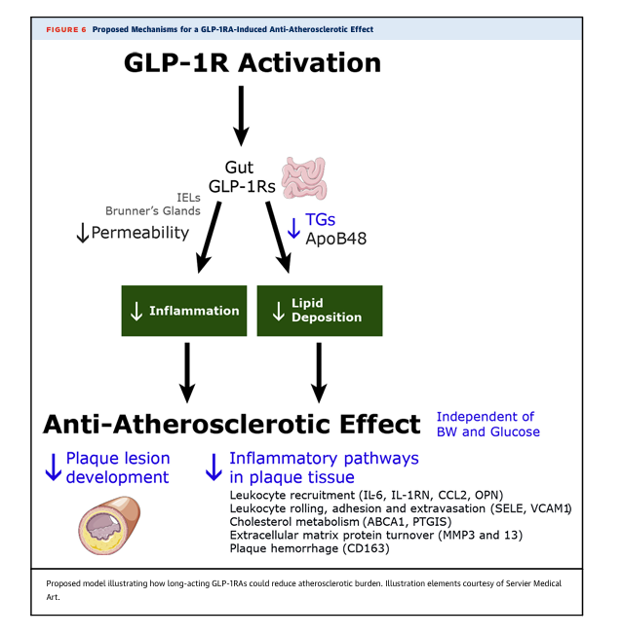


Slide 13

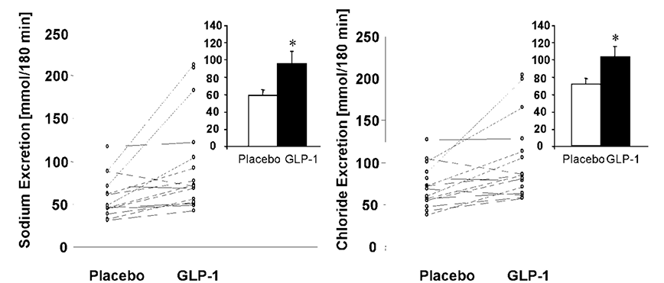


Slide 14

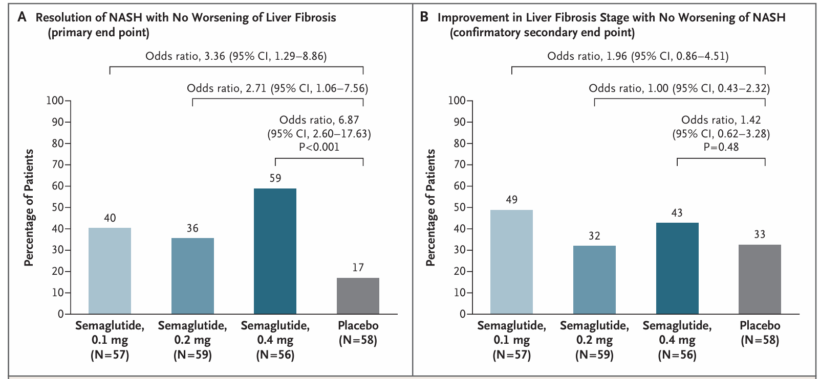

Slide 15

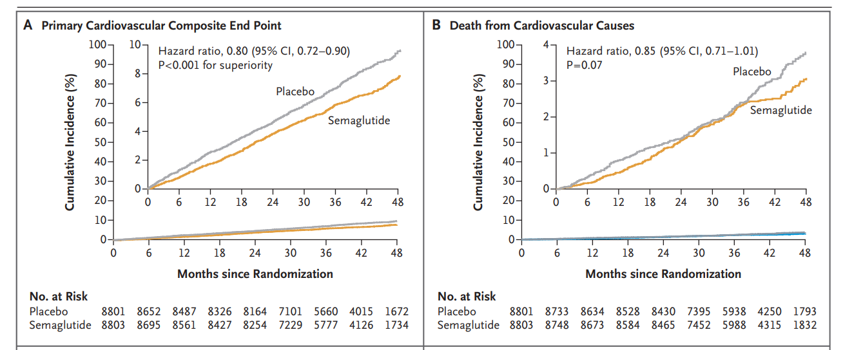

Slide 16

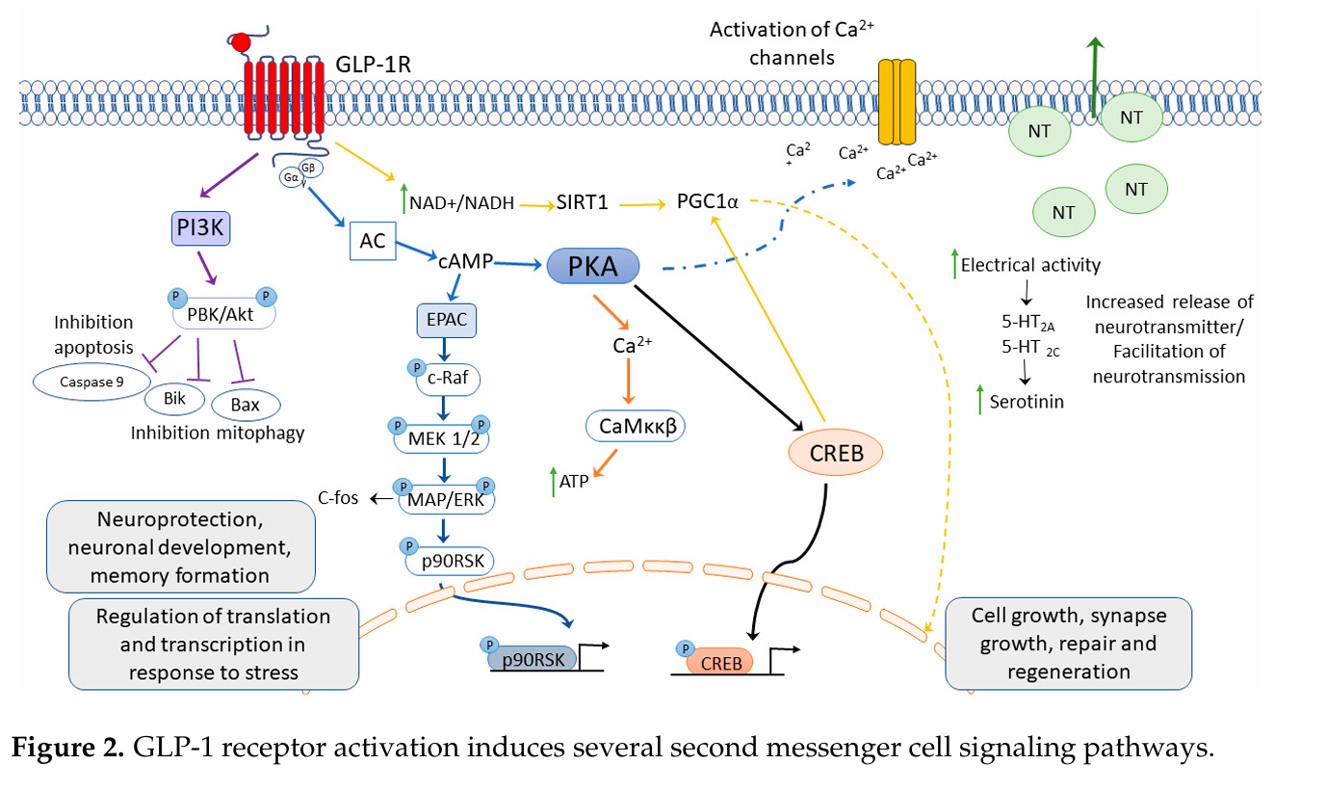


Slide 17
Grazie

